Slide 1
PROJECT PRESENTATION BLACK FRIDAY PROJECT
Notes:
This template can be used as a starter file to give updates for project milestones.
Sections
Right-click on a slide to add sections. Sections can help to organize your slides or facilitate collaboration between multiple authors.
Notes
Use the Notes section for delivery notes or to provide additional details for the audience. View these notes in Presentation View during your presentation.
Keep in mind the font size (important for accessibility, visibility, videotaping, and online production)
Coordinated colors
Pay particular attention to the graphs, charts, and text boxes.
Consider that attendees will print in black and white or grayscale. Run a test print to make sure your colors work when printed in pure black and white and grayscale.
Graphics, tables, and graphs
Keep it simple: If possible, use consistent, non-distracting styles and colors.
Label all graphs and tables.

Slide 2
Project Overview
What is the project about?
Define the goal of this project
Data Collection
Notes:
What is the project about?
Define the goal of this project
Is it similar to projects in the past or is it a new effort?
Define the scope of this project
Is it an independent project or is it related to other projects?
* Note that this slide is not necessary for weekly status meetings

Slide 3
What is the project about?
A retail company “ABC Private Limited” wants to understand the customer purchase behaviour (specifically, purchase amount) against various products of different categories. They have shared purchase summary of various customers for selected high-volume products from last month. The data set also contains customer demographics (age, gender, marital status, city_type, stay_in_current_city), product details (product_id and product category) and Total purchase_amount from last month. Now, they want to build a model to predict the purchase amount of customer against various products which will help them to create personalized offer for customers against different products.

Slide 4
GOAL
The concept of Black Friday is a widely recognized phenomenon that occurs annually in the United States, and increasingly around the world, on the day following Thanksgiving. Black Friday is known for its heavy discounts and promotions, which often result in significant spikes in consumer spending.
In recent years, machine learning algorithms have been applied to analyse and predict consumer behaviour on Black Friday. One of the most common applications is to identify the most important product categories and features that affect consumer purchases during the event.
To achieve this, machine learning algorithms can be trained on historical sales data, consumer demographics, and other relevant factors to identify patterns and correlations in the data. This can help to identify which product categories are most popular during Black Friday, as well as which features (such as price, brand, or product attributes) are most influential in driving consumer purchases.
Once these patterns have been identified, developers and marketers can use this information to inform their strategies for promoting and selling products during Black Friday. For example, they might focus on promoting products in the most popular categories or highlighting specific features that are known to be particularly influential in driving sales.
Overall, the use of machine learning in analyzing and predicting consumer behavior on Black Friday has the potential to help businesses make more informed decisions about their marketing and sales strategies, leading to more successful Black Friday events and increased revenue.

Slide 5
DATA COLLECTION
Data was given by the client
• Data • Variable Definition • User_ID User ID • Product_ID Product ID • Gender Sex of User • Age Age in bins • Occupation Occupation (Masked) • City_Category Category of the City (A,B,C) • Stay_In_Current_City_Years Number of years stay in current city • Marital_Status Marital Status • Product_Category_1 Product Category (Masked) • Product_Category_2 Product may belongs to other category also (Masked) • Product_Category_3 Product may belongs to other category also (Masked) • Purchase Purchase Amount (Target Variable)

Slide 6
Shape of DATA
Data columns (total 12 columns): # Column Non-Null Count Dtype --- ------ -------------- ----- 0 User_ID 550068 non-null int64 1 Product_ID 550068 non-null object 2 Gender 550068 non-null object 3 Age 550068 non-null object 4 Occupation 550068 non-null int64 5 City_Category 550068 non-null object 6 Stay_In_Current_City_Years 550068 non-null object 7 Marital_Status 550068 non-null int64 8 Product_Category_1 550068 non-null int64 9 Product_Category_2 376430 non-null float64 10 Product_Category_3 166821 non-null float64 11 Purchase 550068 non-null int64

Slide 7
DATA CLEANING
We have removed the null values from the Product_Category_2 and 3 and have replaced it with 0 as the amt spent by that transaction on that product is nil and we cant have null values as we cant run the model steps with null values.

Slide 8
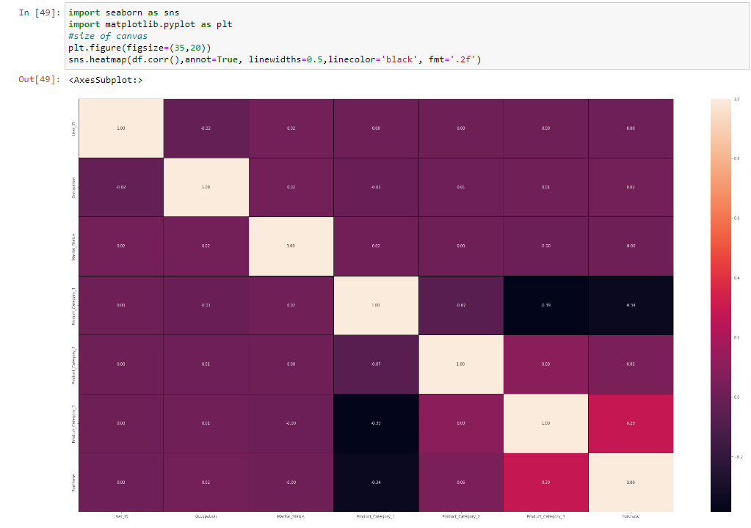
Correlation

Slide 9
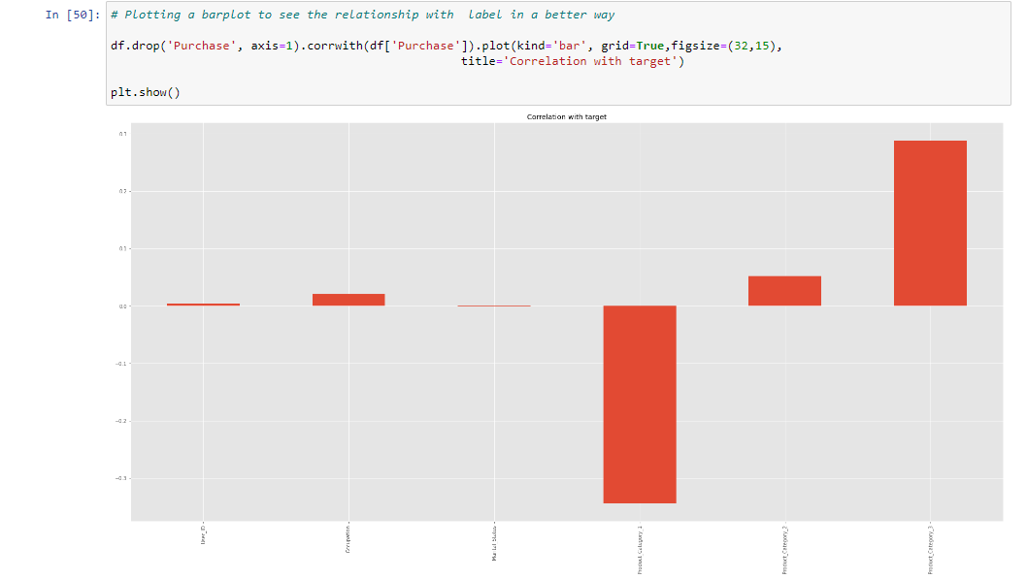
Top more correlated with Target

Slide 10
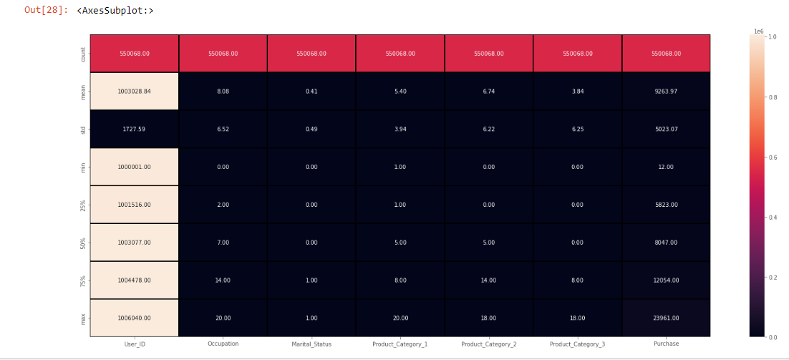
Visualization - EDA

Slide 11
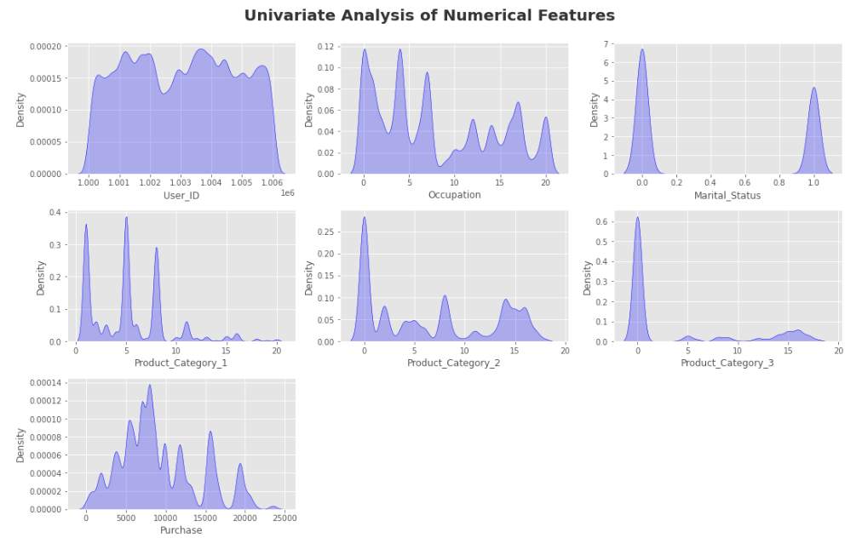

Slide 12
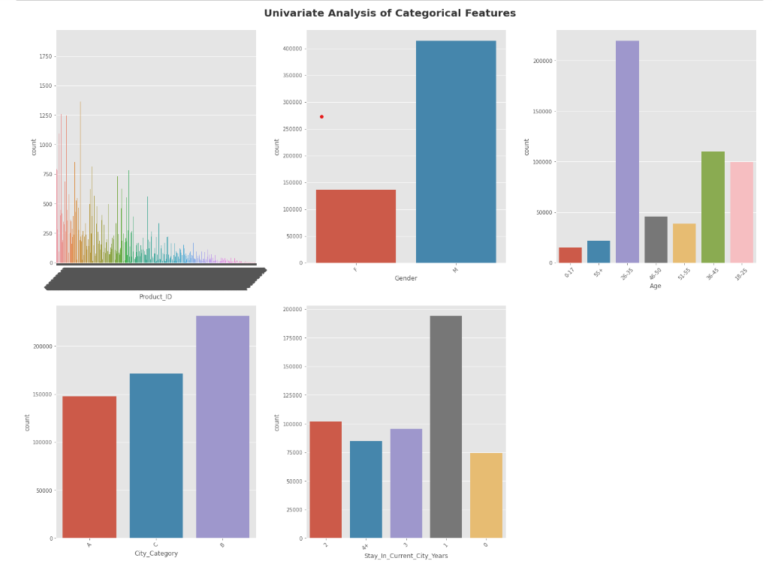

Slide 13
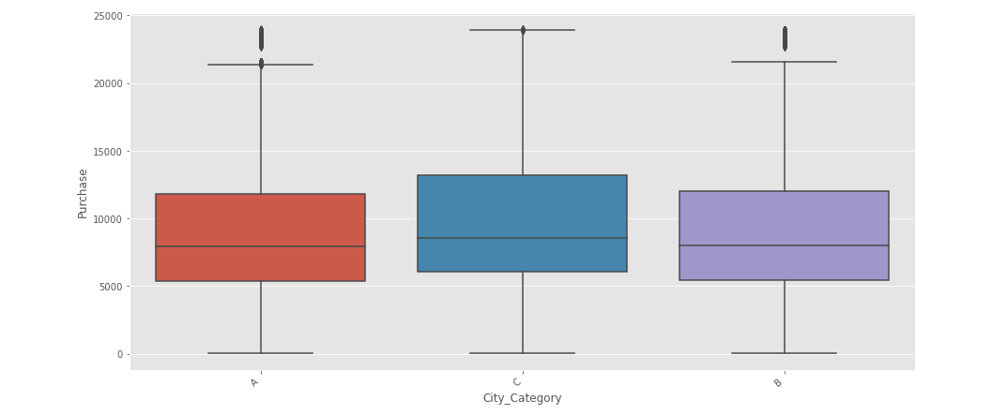

Slide 14
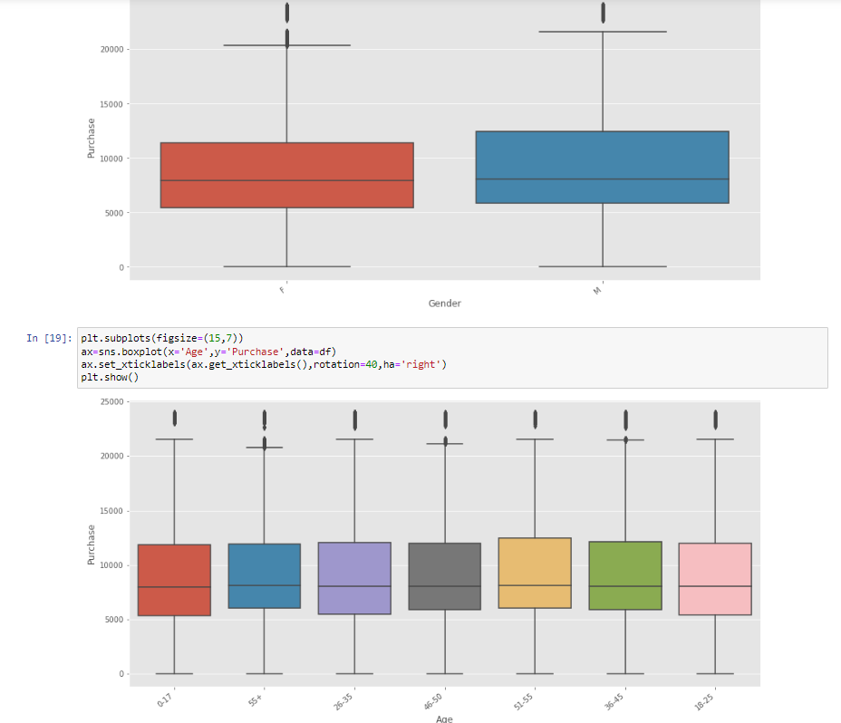

Slide 15
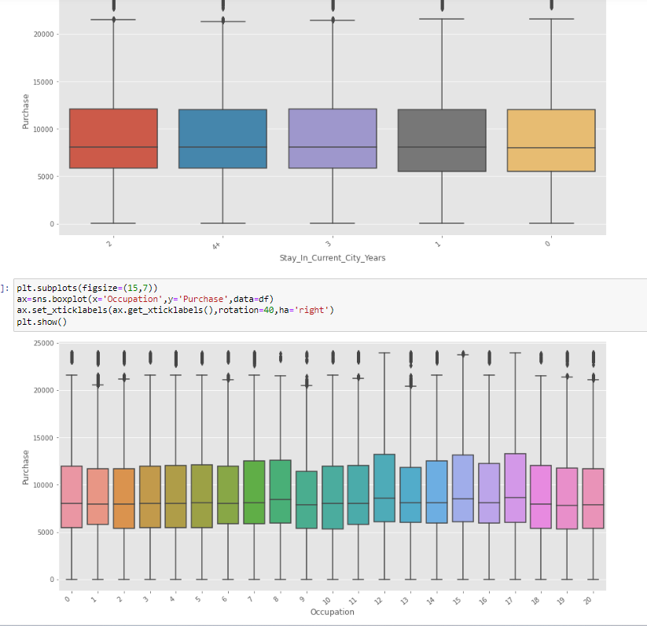

Slide 16
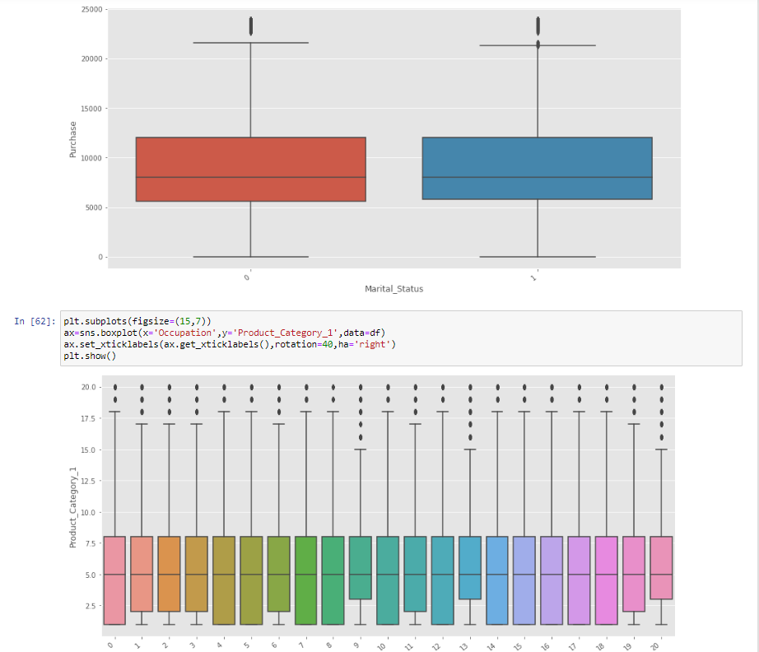

Slide 17
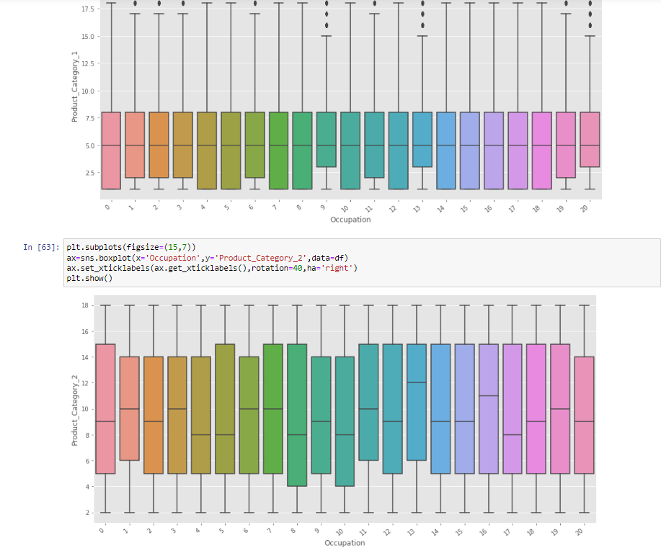

Slide 18
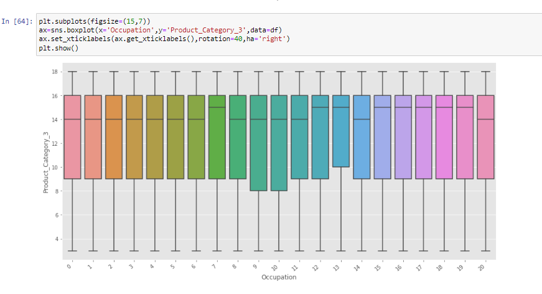

Slide 19
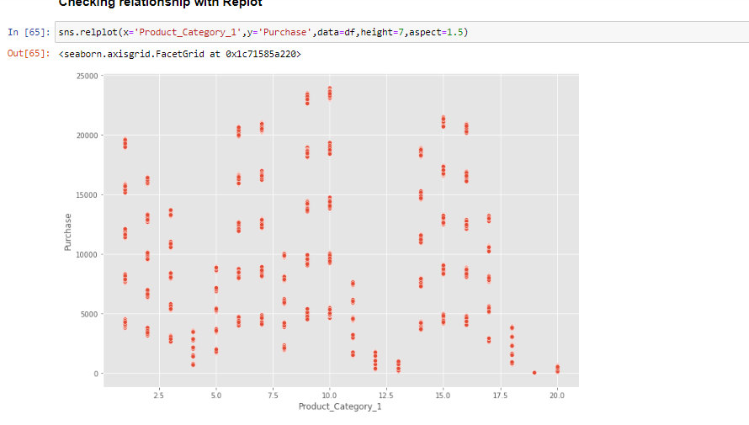

Slide 20
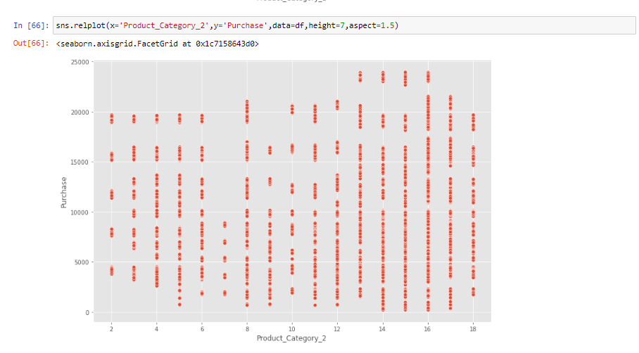

Slide 21
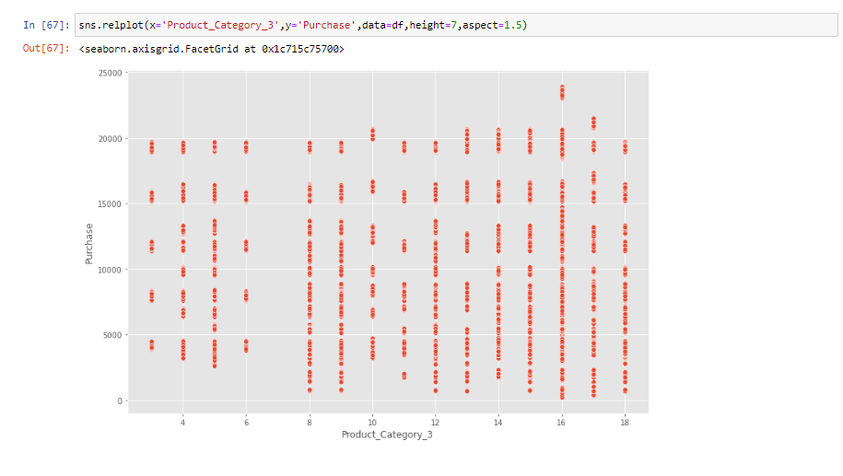

Slide 22
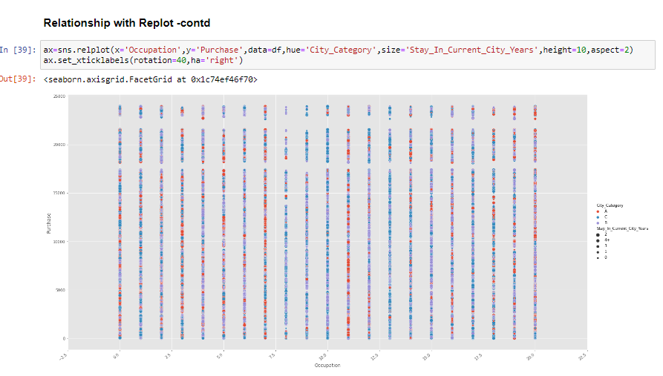

Slide 23
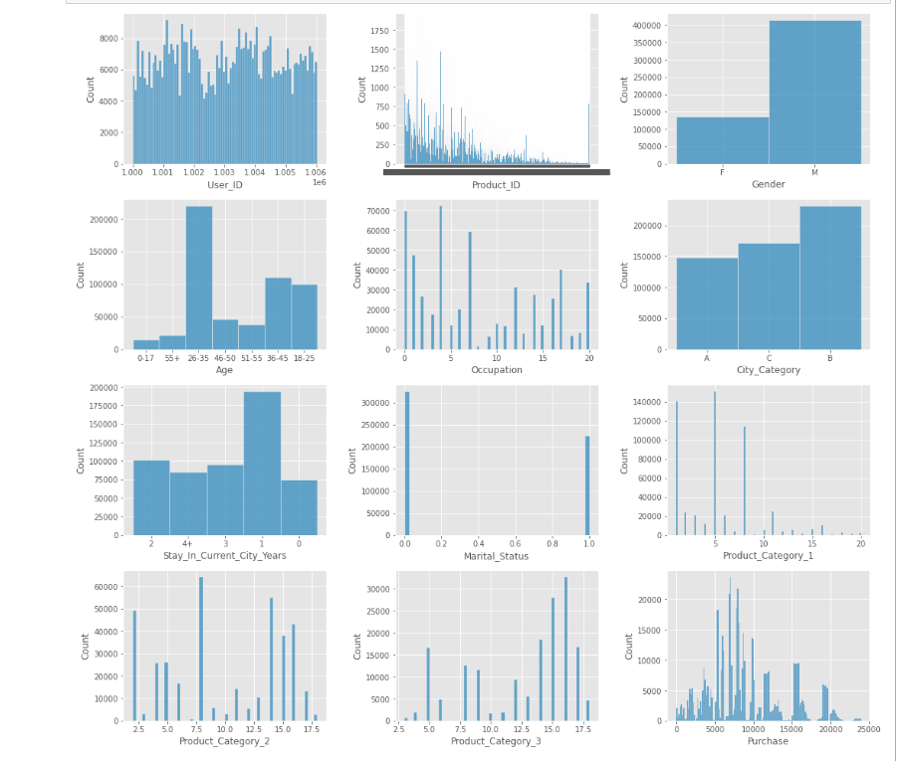

Slide 24
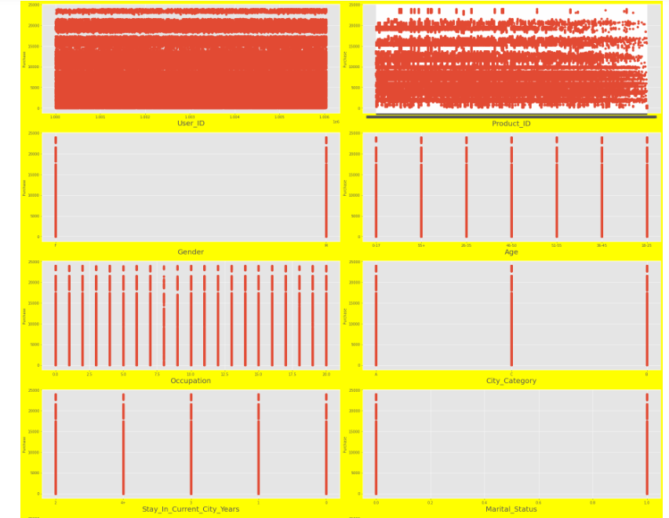
Relationship with Target (Price)

Slide 25
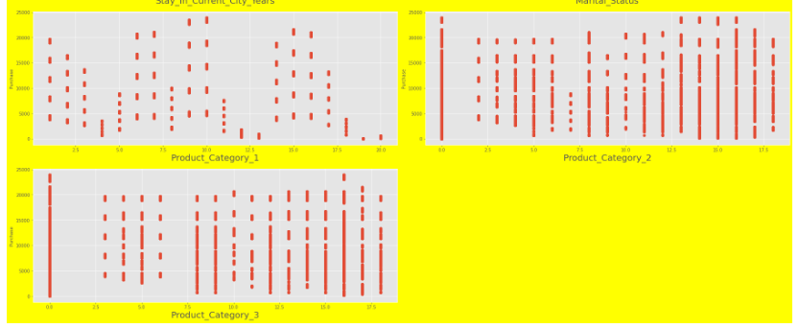

Slide 26
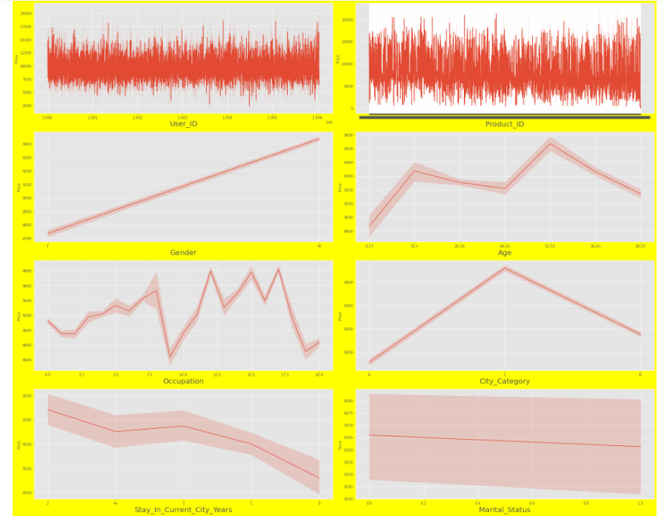

Slide 27
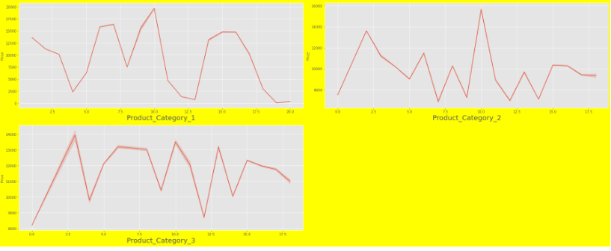

Slide 28
OBSERVATIONS FROM EDA
Studies from the data and the EDA done :
We see in the describe chart the numerical columns where, Occupation, Martial Status are categorical,
We see that in Pro_category 1, mean is 5.4 and std 3.94 which shows high variance , the same trend is seen for Product_category 2 & 3 ,
In Product Category 1,2 & 3 we see that the min is 0 and the max is 18 or more , which shows that there are transactions where there is no purchase of either of the products and they are all varied
The label purchase seems to have really high variance where the min is 12 and the max is 23961 which is really high and we need to treat them if we are to make a model of them,
In the kdeplot graphs we see the same trend as the columns show that they are right skewed
For categorical features , we see that the majority of transactions been done by males , we see that the age shows that 26-35 is the highest and in city B is the highest, and the stay in current city category shows that the maximum is 1
Box plot analysis between features and Label- we see that the purchase band of city , gender , age, stay in current city ,occupation , martial status is equal not showing much variation , but we do see a lot of outliers in each , but overall people spending the same average amounts
In the relationship between Pro_category 1,2& 3 with features , we see that the different is also similar but we do see outliers as we did in the previous analysis
In the Replot analysis we see that Prod_category 1 has the lowest impact on the purchase as we see that the number of points is lesser compared to the prod_category 2 & 3
In the corr plot we see that Prod category 2 & 3 have the highest correlation with the label, prod category 1 has the highest negative correlation with the label
In the heatmap for coreelation we see that the features dont really have any multicollinearity issue and we can move to other issues

Slide 29
Conclusion
In conclusion, the Black Friday sales data analytics project provided valuable insights into consumer behavior and preferences during the biggest shopping day of the year. Through exploratory data analysis and data visualization techniques, we were able to identify trends and patterns in the data, such as the higher spending patterns among males and the preference for certain product categories.
The project also demonstrated the usefulness of machine learning models in predicting customer purchase behavior and providing personalized product recommendations. The models were able to accurately predict whether a customer would make a purchase based on their demographics and shopping history, which can be useful for targeted marketing efforts and improving customer experience.
However, there were limitations to the project, such as the lack of information on customer preferences and motivations for their purchases, as well as the limited scope of the data set. Future work could involve collecting more comprehensive data on customer behavior and preferences, as well as exploring additional machine learning algorithms and techniques for predictive modeling.
Overall, the Black Friday sales data analytics project showcased the power of data science and data analytics in providing insights and recommendations for businesses to improve their marketing strategies and customer experience.

